Slide 1
Chapter 15 The Foreign Exchange Markets

Slide 2
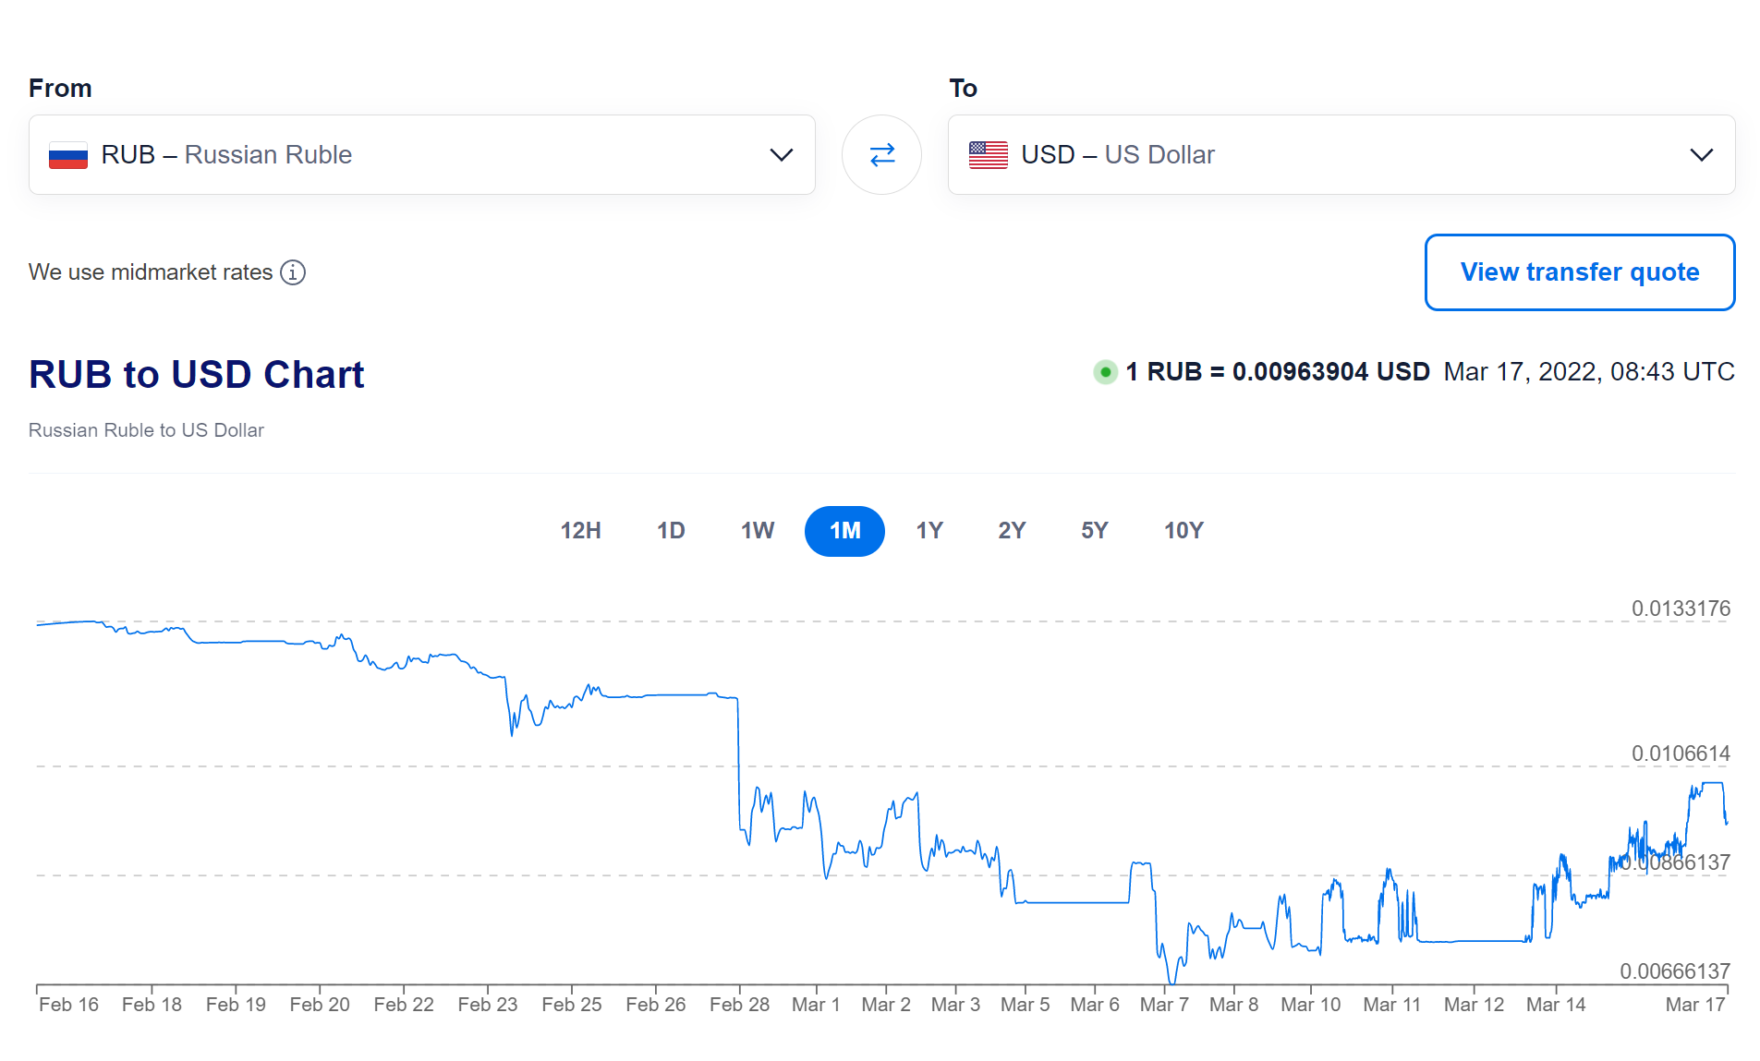

Slide 3
Chapter Preview
In this chapter, we develop a modern view of exchange rate determination that explains recent behavior in the foreign exchange market. Topics include:
Foreign Exchange Market
Exchange Rates in the Long Run
Exchange Rates in the Short Run
Explaining Changes in Exchange Rates
3

Slide 4
Foreign Exchange Market
Most countries of the world have their own currencies: the U.S dollar., the euro in Europe, the Brazilian real, and the Chinese yuan, just to name a few.
The trading of currencies and banks deposits is what makes up the foreign exchange market.
4

Slide 5
What are Foreign Exchange Rates?
Two kinds of exchange rate transactions make up the foreign exchange market:
Spot transactions involve the near-immediate exchange of bank deposits, completed at the spot rate.
Forward transactions involve exchanges at some future date, completed at the forward rate.
5

Slide 6
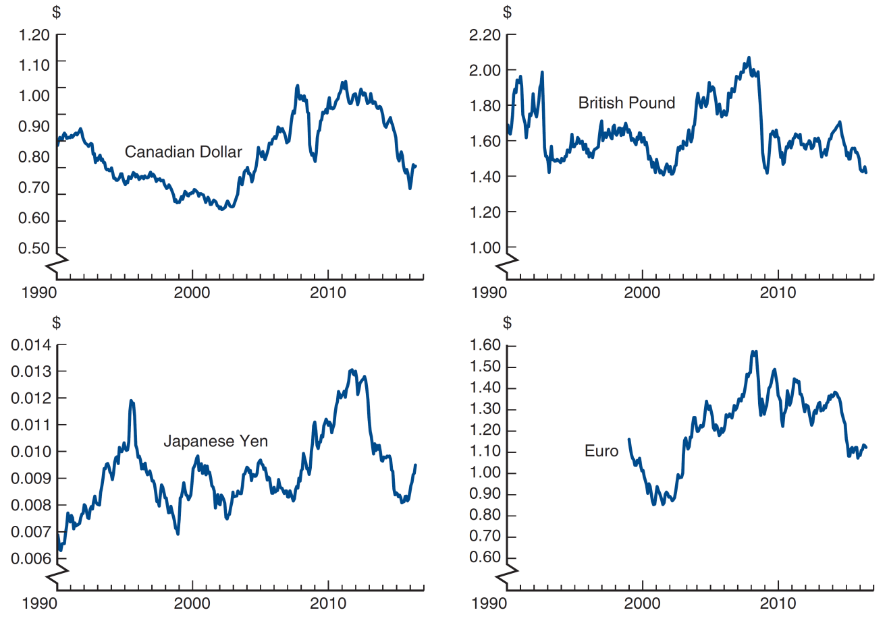
Figure 15.1 Exchange Rates, 1990–2016
Source: Federal Reserve Bank of St. Louis FRED database: https://fred.stlouisfed.org/series/EXCAUS; https://fred.stlouisfed.org/series/EXUSUK; https://fred.stlouisfed.org/series/EXJPUS; https://fred.stlouisfed.org/series/EXUSEU.
6

Slide 7
Why Are Exchange Rates Important? (1 of 2)
When the currency of your country appreciates relative to another country, your country’s goods prices ↑ abroad and foreign goods prices ↓ in your country.
Makes domestic businesses less competitive
Benefits domestic consumers (you)
7

Slide 8
Why Are Exchange Rates Important? (2 of 2)
For example, in 1999, the euro was valued at $1.18. On June 16, 2016, it was valued at $1.1132.
Euro depreciated 5.6% (1.1132 − 1.18) / 1.18
Dollar appreciated 6.0% (0.898 − 0.847) / 0.847
Note: 0.89 = 1 / 1.11, and 0.847 = 1 / 1.18
8

Slide 9
Foreign Exchange Market: Exchange Rates
FOLLOWING THE FINANCIAL NEWS
Foreign Exchange Rates
Foreign exchange rates are published daily in newspapers and Internet sites such as www.finance.yahoo.com. Exchange rates for a currency such as the euro are quoted in two ways: U.S. dollars per unit of domestic currency or domestic currency per U.S. dollar. For example, on June 16, 2016, the euro exchange rate was quoted as $1.1132 per euro and 0.8983 euro per dollar. Americans generally would regard the exchange rate with the euro as $1.11 per euro, while Europeans think of it as 0.90 euro per dollar.
Exchange rates are quoted for the spot transaction (the spot exchange rate) and for forward transactions (the forward exchange rates) that will take place one month, three months, and six months in the future.
9

Slide 10
How is Foreign Exchange Traded?
FX traded in over-the-counter market
Involve buying / selling bank deposits denominated in different currencies.
Trades involve transactions in excess of $1 million.
Typical consumers buy foreign currencies from retail dealers, such as banks.
FX volume exceeds $5 trillion per day.
10

Slide 11
Exchange Rates in the Long Run
Exchange rates are determined in markets by the interaction of supply and demand.
An important concept that drives the forces of supply and demand is the Law of One Price.
11

Slide 12
Exchange Rates in the Long Run: Law of One Price (1 of 2)
The Law of One Price states that the price of an identical good will be the same throughout the world, regardless of which country produces it.
Example: American steel costs $100 per ton, while Japanese steel costs 10,000 yen per ton.
12

Slide 13
Exchange Rates in the Long Run: Law of One Price (2 of 2)
If E = 50 yen/$ then price are: | Blank | Blank
Blank | American Steel | Japanese Steel
In U.S. | $100 | $200
In Japan | 5000 yen | 10,000 yen
Blank | Blank | Blank
If E = 100 yen/$ then price are: | Blank | Blank
Blank | American Steel | Japanese Steel
In U.S. | $100 | $100
In Japan | 10,000 yen | 10,000 yen
13

Slide 14
Exchange Rates in the Long Run: Theory of Purchasing Power Parity (PPP) (1 of 2)
The theory of PPP states that exchange rates between two currencies will adjust to reflect changes in price levels.
Real exchange rate (R) = the rate at which domestic goods can be exchanged for foreign goods
R = E x relative domestic price level
PPP ⇒ R = 1, E = relative foreign price level
PPP ⇒ Domestic price level ↑ 10%, domestic currency ↓ 10%
Application of law of one price to price levels
Works in long run, not short run
14

Slide 15
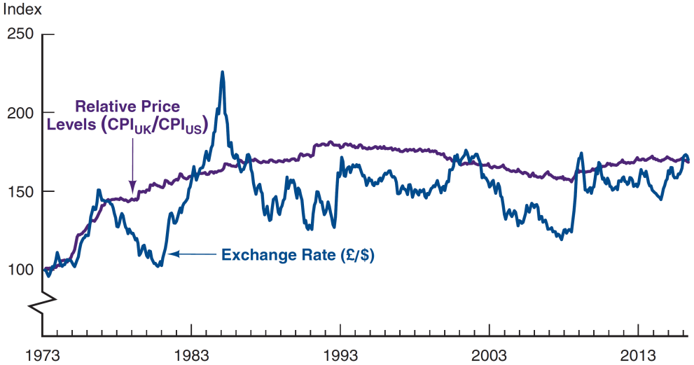
Figure 15.2 Purchasing Power Parity, United States/United Kingdom, 1973–2016 (Index: March 1973 = 100)
Source: Federal Reserve Bank of St. Louis FRED database: https://fred.stlouisfed.org/series/CP0000GBM086NEST; https://fred.stlouisfed.org/series/CPIAUCNS; https://fred.stlouisfed.org/series/EXUSUK.
15

Slide 16
Exchange Rates in the Long Run: Theory of Purchasing Power Parity (PPP) (2 of 2)
Problems with PPP
All goods are not identical in both countries (i.e., Toyota versus Tesla)
Many goods and services are not traded (e.g., haircuts, land, etc.)
16

Slide 17
Exchange Rates in the Long Run: Factors Affecting Exchange Rates in Long Run (1 of 3)
Basic Principle: If a factor increases demand for domestic goods relative to foreign goods, the exchange rate ↑
The four major factors are relative price levels, tariffs and quotas, preferences for domestic vs. foreign goods, and productivity.
17

Slide 18
Exchange Rates in the Long Run: Factors Affecting Exchange Rates in Long Run (2 of 3)
Relative price levels: a rise in relative price levels cause a country’s currency to depreciate.
Tariffs and quotas: increasing trade barriers causes a country’s currency to appreciate.
18

Slide 19
Exchange Rates in the Long Run: Factors Affecting Exchange Rates in Long Run (3 of 3)
Preferences for domestic vs. foreign goods: increased demand for a country’s good causes its currency to appreciate; increased demand for imports causes the domestic currency to depreciate.
Productivity: if a country is more productive relative to another, its currency appreciates.
19

Slide 20
Table 15.1 Summary Factors That Affect Exchange Rates in the Long Run
Factor | Change in Factor | Response of the Exchange Rate, E* (in terms of domestic currency)
Domestic price level | Increase | Depreciation
Trade barriers | Increase | Appreciation
Import demand | Increase | Depreciation
Export demand | Increase | Appreciation
Productivity | Increase | Appreciation
20

Slide 21
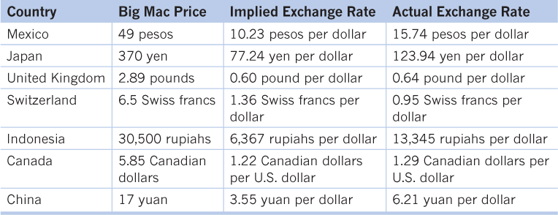
The Big Mac theory of exchange rates
The Economist collects the prices of Big Macs in different countries.
In July 2015, the average price of a Big Mac was $4.79 in the United States.
Comparing this to the average prices of Big Macs in other countries offers a (light-hearted) test of purchasing power parity:

Slide 22
Exchange Rates in the Short Run
In the short run, an exchange rate is the price of domestic bank deposits in terms of foreign bank deposits.
We will rely on the tools for the determinants of asset demand.
The usual approach to supply-demand analysis focused on import/export demand
Could not predict substantial fluctuations in exchange rates.
The more modern asset market approach used here emphasizes stocks of assets rather than the flows of exports and imports over short periods because export and import transactions are small relative to the amount of domestic and foreign assets at any given time.
Foreign exchange transactions in the United States each year are well over 25 times greater than the amount of U.S. exports and imports.
22

Slide 23
Exchange Rates in the Short Run: Supply Curve Analysis
We will use the US as the “home country,” so domestic assets are denominated in US dollars. We will use “euros” the generically represent any foreign country's currency.
Dollar assets supplied is primarily the quantity of bank deposits, bonds, and equities in the United States. This is fairly fixed in the short-run.
The quantity supplied at any exchange rate does not change, so the supply curve, S, is vertical.
23

Slide 24
Exchange Rates in the Short Run: Demand Curve Analysis
The demand curve traces out the quantity demanded at each current exchange rate
The current exchange rate and the expected future exchange rate are held constant in this analysis.
Let’s see a specific example that illustrates this point.
24

Slide 25
Deriving the Demand Curve
Assume E^{e}_{t+1} = 1 euro/$ | Blank
Point | Blank
A: E_{t} = 1.05 | (1.00 – 1.05)/1.05 = −4.8%
B: E_{t} = 1.00 | (1.00 – 1.00)/1.00 = 0.0%
C: E_{t} = 0.95 | (1.00 – 0.95)/0.95 = 5.2%
The demand curve connects these points and is downward sloping because when E^{t} is higher, expected appreciation of the dollar is higher.
25

Slide 26
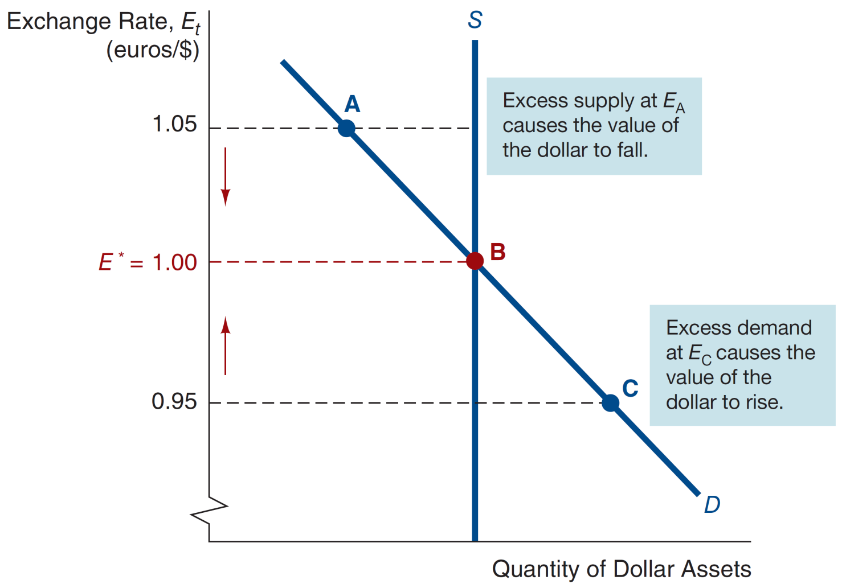
Figure 15.3 Equilibrium in the Foreign Exchange Market
Equilibrium
Supply = Demand at E*
If E_{t} > E*, Demand < Supply, buy $, E_{t} ↑
If E_{t} < E*, Demand > Supply, sell $, E_{t} ↓
26

Slide 27
Explaining Changes in Exchange Rates
The quantity of domestic (dollar) assets demanded depends on the relative expected return of dollar assets.
When a factor changes, decide whether at a given level of the current exchange rate, holding all other variables constant, you would earn a higher or lower expected return on dollar assets versus foreign assets.
If the relative expected return of dollar assets rises, holding the current exchange rate constant, the demand curve shifts to the right. If the relative expected return falls, the demand curve shifts to the left.
Factors
Domestic Interest Rate, i^{D}
Foreign Interest Rate, i^{F}
Expected Future Exchange Rate, E^{e}_{t+1}
27

Slide 28
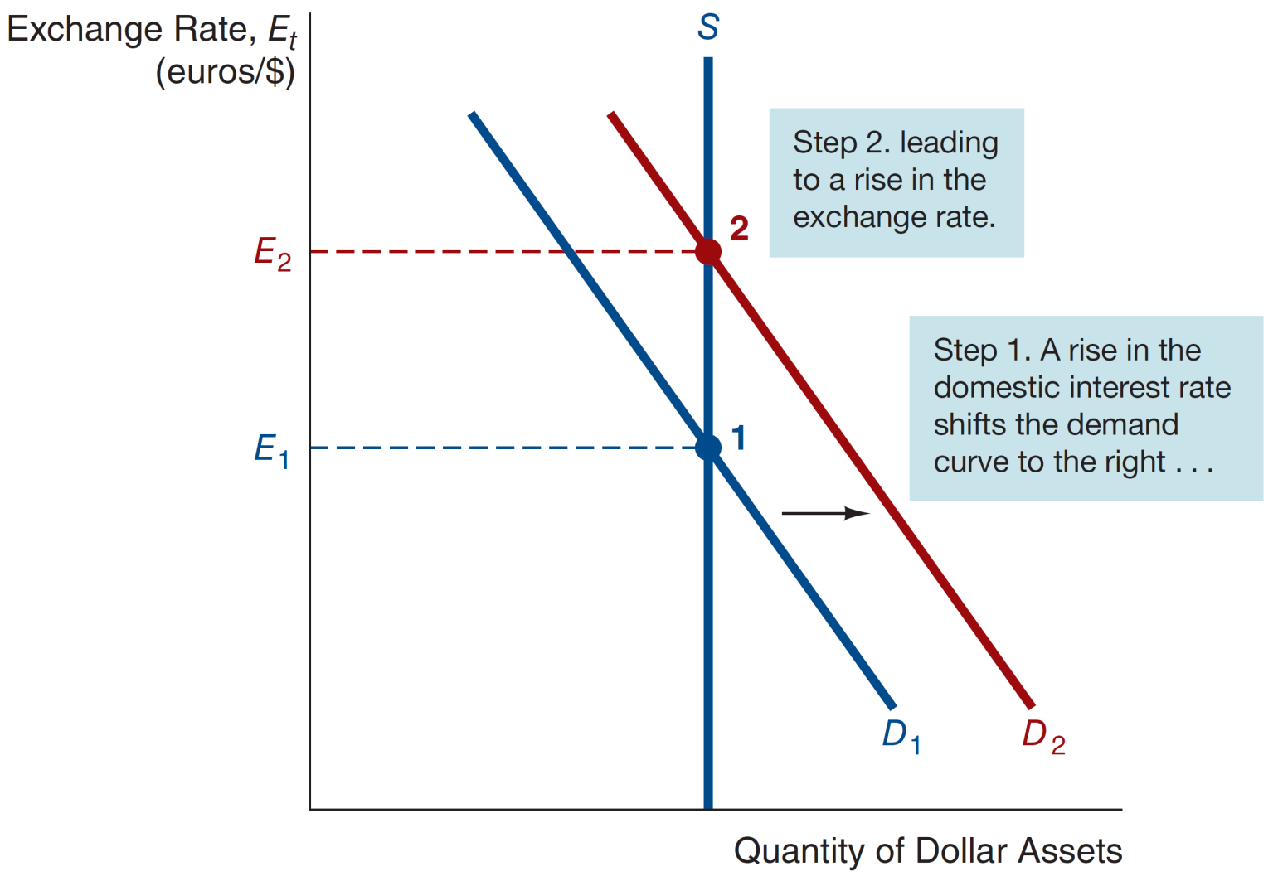
Figure 15.4 Response to an Increase in the Domestic Interest Rate, i^{D}
28

Slide 29
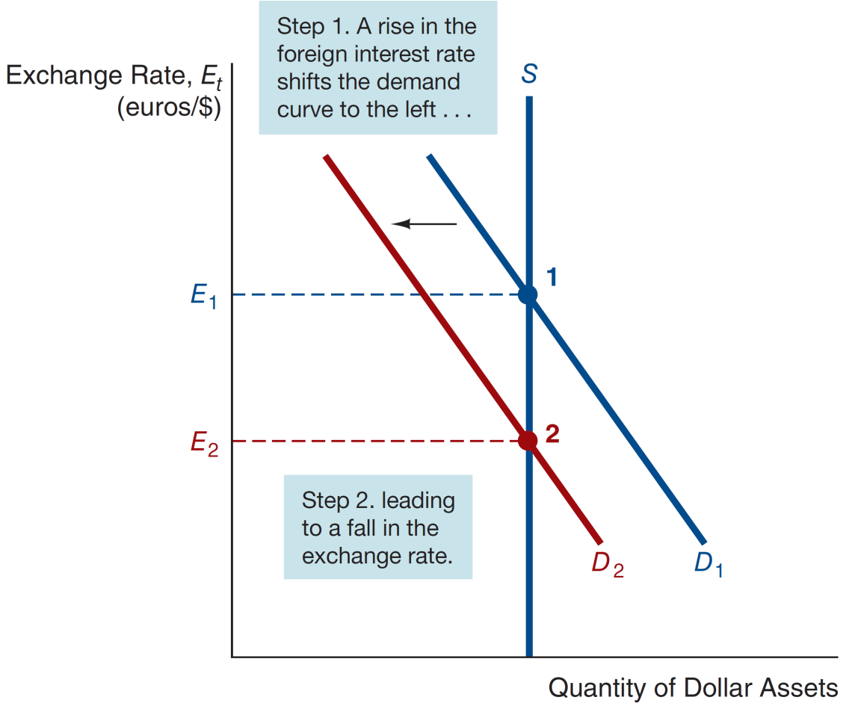
Figure 15.5 Response to an Increase in the Foreign Interest Rate, i^{F}
29

Slide 30
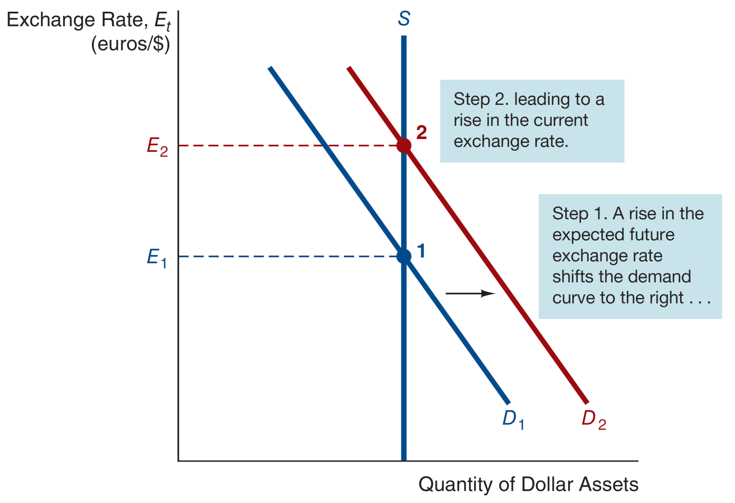
Figure 15.6 Response to an Increase in the Expected Future Exchange Rate, E^{e}_{t+1}
30

Slide 31
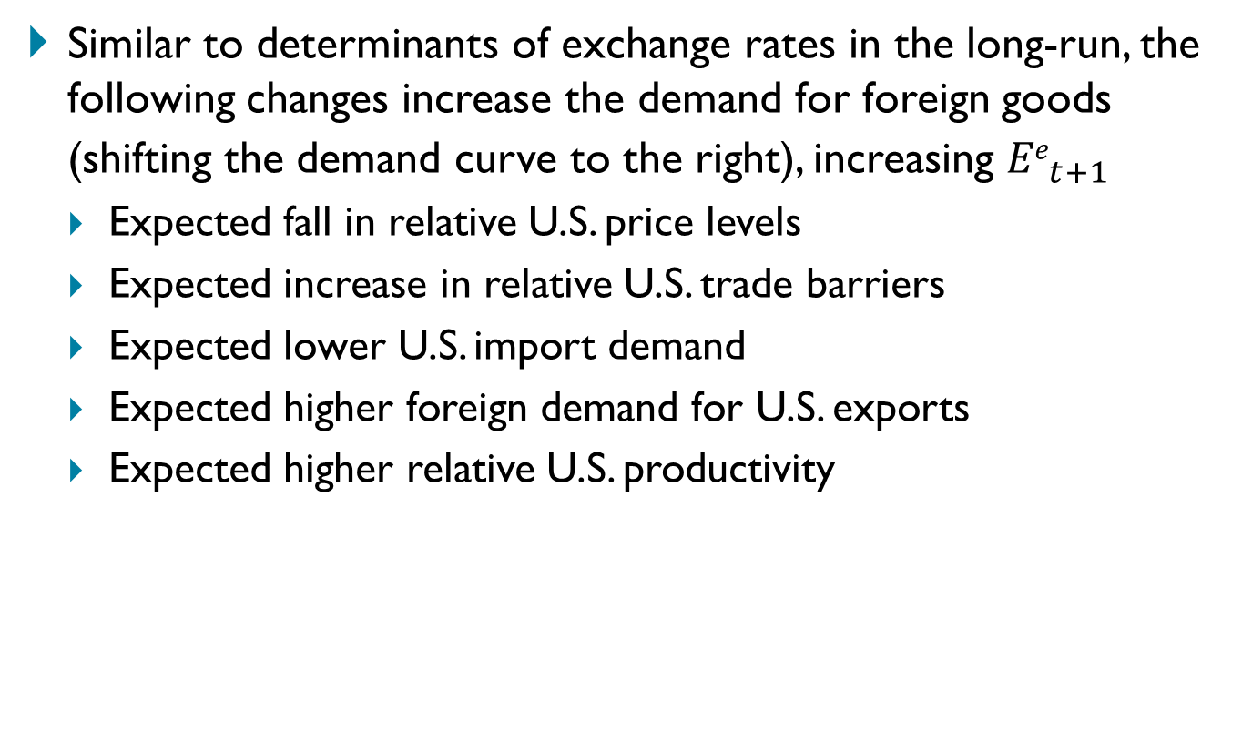
Explaining Changes in Exchanges Rates
Similar to determinants of exchange rates in the long-run, the following changes increase the demand for foreign goods (shifting the demand curve to the right), increasing ${Ee}_{t+1}^{}$
Expected fall in relative U.S. price levels
Expected increase in relative U.S. trade barriers
Expected lower U.S. import demand
Expected higher foreign demand for U.S. exports
Expected higher relative U.S. productivity
31

Slide 32
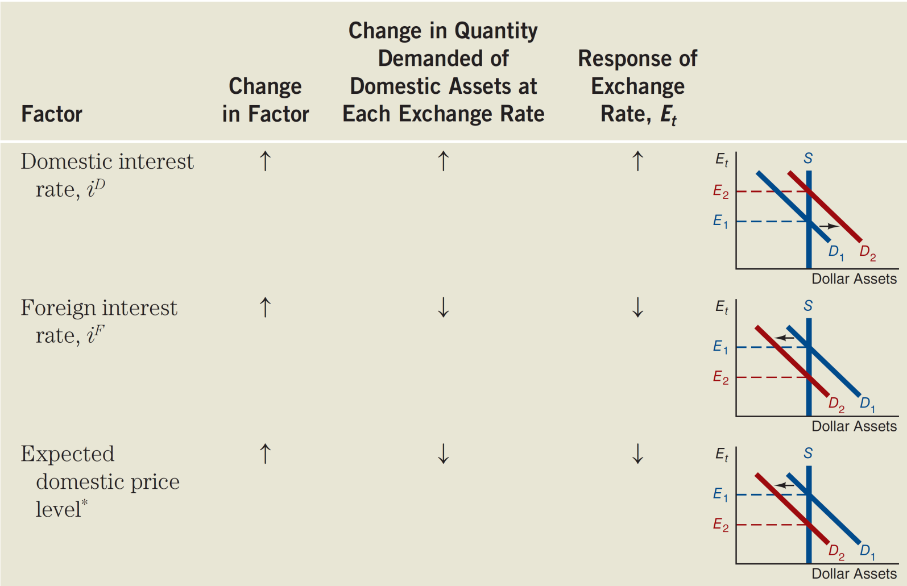
Table 15.2 Summary: Summary Factors That Shift the Demand Curve for Domestic Assets and Affect the Exchange Rate (1 of 2)
32

Slide 33
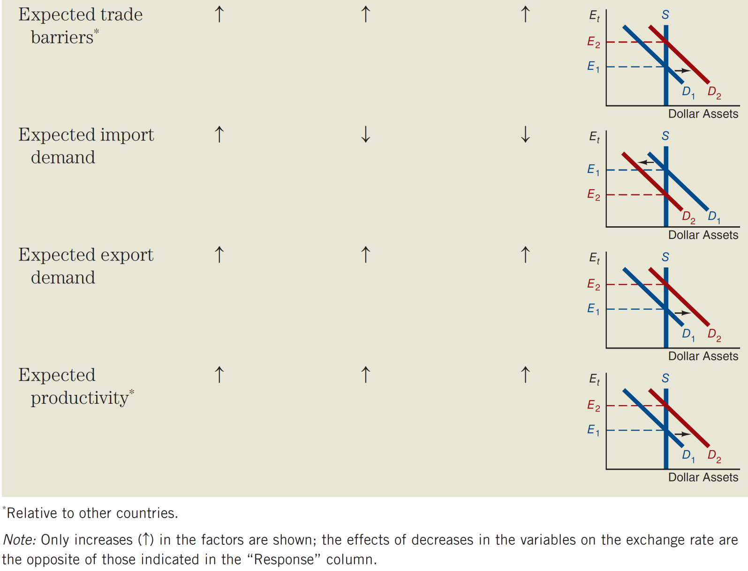
Table 15.2 Summary: Summary Factors That Shift the Demand Curve for Domestic Assets and Affect the Exchange Rate (2 of 2)
33

Slide 34
Exchange rate volatility
Changes in the expected appreciation of exchange rates. As anything changes our expectations (price levels, productivity, inflation, etc.), exchange rates will change immediately.
Another explanation deals with Exchange rate overshooting.
The initial jump takes the exchange rate beyond its new equilibrium level.
34

Slide 35
Application: Interest Rate Changes
Changes in domestic interest rates are often cited in the press as affecting exchange rates.
We must carefully examine the source of the change to make such a statement. Interest rates change because either (a) the real rate or (b) the expected inflation is changing. The effect of each differs.
35

Slide 36
Effect of Changes in Interest Rates on the Equilibrium Exchange Rate
When the domestic real interest rate increases, the domestic currency appreciates.
The domestic real interest rate increases so that the nominal interest rate i^{D} rises while expected inflation remains unchanged.
It is reasonable to assume that the expected future exchange rate is unchanged because expected inflation is unchanged.
The increase in i^{D} increases the relative expected return on dollar assets.
When the domestic expected inflation increases, the domestic currency reacts in the opposite direction—it depreciates.
The rise in expected domestic inflation leads to a decline in the expected appreciation of the dollar.
As a result, at any given exchange rate, the relative expected return on domestic (dollar) assets falls, the demand curve shifts to the left.
36

Slide 37
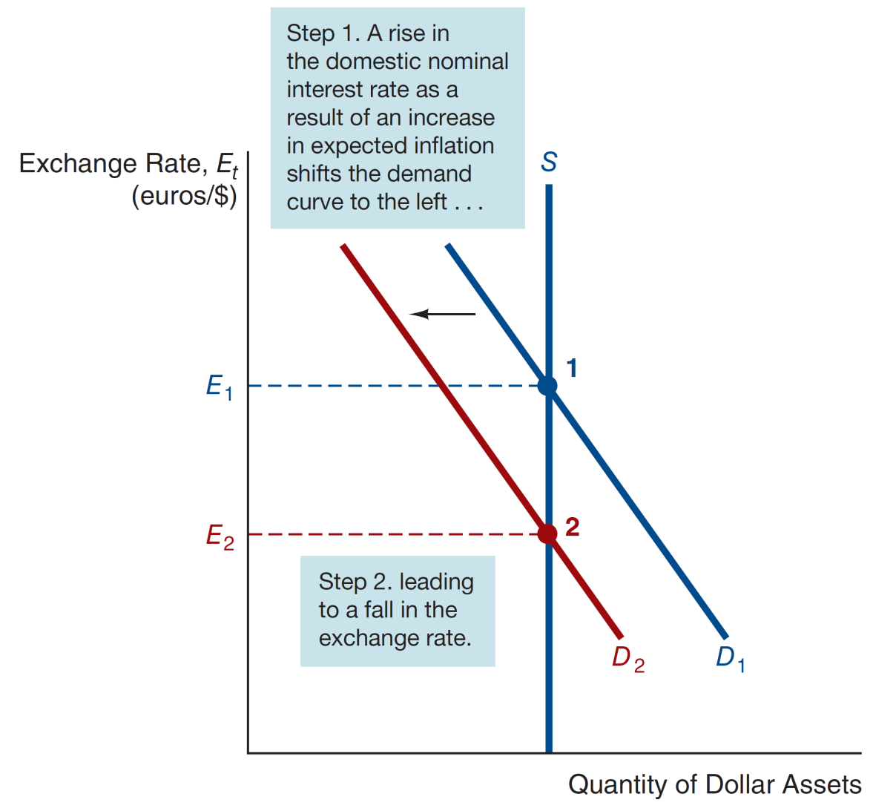
Figure 15.7 Effect of a Rise in the Domestic Interest Rate as a Result of an Increase in Expected Inflation
37

Slide 38
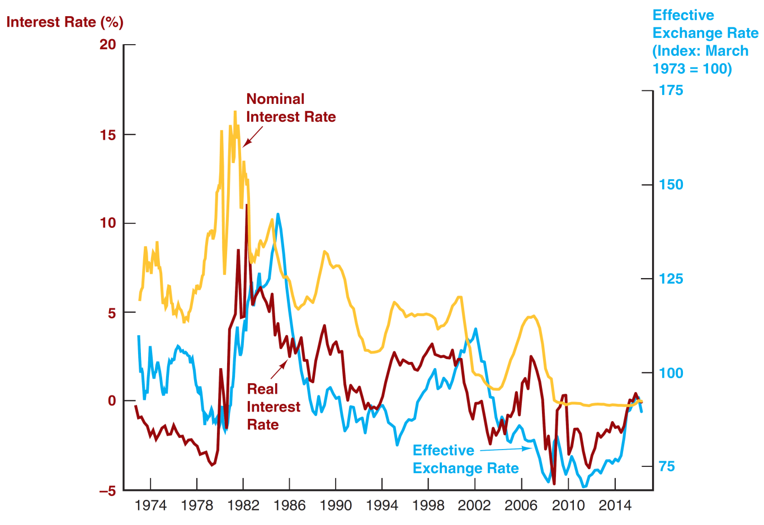
Figure 15.8 Value of the Dollar and Interest Rates, 1973–2016
A failure to distinguish between real and nominal interest rates can lead to poor predictions of exchange rate movements!
the value of the dollar in terms of a basket of foreign currencies
Source: Federal Reserve Bank of St. Louis FRED database: https://fred.stlouisfed.org/series/TWEXMMTH; https://fred.stlouisfed.org/series/TB3MS; real interest rate from Figure 3.1 in Chapter 3.
38

Slide 39
Case: The Global Financial Crisis and the Dollar (1 of 2)
Is there a relationship between the subprime crisis and swings in the value of the dollar?
In August 2007, the dollar began an accelerated decline in value, falling by 9% against the euro through July 2008
The dollar suddenly shot upward, by over 20% against the euro by the end of October 2008.
39

Slide 40
Case: The Global Financial Crisis and the Dollar
In 2007, the Fed lowered the fed funds rate by 325 bps, while ECBs did not need to do this. Relative return on the dollar fell, shifting demand to the left.
By mid-2008, ECBs starting cutting their domestic rates, increasing the relative expected return of the US dollar (a rightward shift). A “flight to quality” in T-bonds also increased the demand for dollars.
40

Slide 41
The Practicing Manger: Profiting from FX Forecasts
Managers of financial institutions care a great deal about what foreign exchange rates will be in the future
Affect the value of assets on their balance sheet that are denominated in foreign currencies.
Engage in trading foreign exchange both for their own account and for their customers
Forecasters look at factors discussed here
FX forecasts affect financial institutions managers' decisions
If forecast euro appreciates and yen depreciates against USD,
Sell USD assets, buy euro assets
Make more euros loans, less yen loans
FX traders sell yen, buy euros
41

Slide 42
Chapter Summary
Foreign Exchange Market: the market for deposits in one currency versus deposits in another.
Exchange Rates in the Long Run: driven primarily by the law of one price as it affects the four factors discussed.
Exchange Rates in the Short Run: short-run rates are determined by the demand for assets denominated in both domestic and foreign currencies.
Explaining Changes in Exchange Rates: factors leading to shifts in the demand and supply schedules were explored.
42

